Slide 1
Applied Machine Learning
Project Group - 1
Forecasting Stock Volatility
September 15, 2023

Slide 2
Motivation
Accurately forecasting volatility is essential for the trading of stocks
Helps the trader to expect fluctuation and manage risk.
High volatility is associated with large price swings
Low volatility describes more calm and quiet markets.
Volatility of the underlying security is one of the key features for predicting Futures and Options price.

Slide 3
Project & Data - Introduction
We have used data from Kaggle Competition - Optiver Realized Volatility Prediction - Link
The Dataset contains order book snapshots and executed trades (bid-ask spread, price, realized volatility, and order execution timestamps).
The goal is to build new features, and use them forecast the volatility
We have order book snapshots and executed trades at one second resolution.
Files - book_train.parquet, trade_train.parquet , train.csv

Slide 4
Project & Data - Introduction
Data Description
Size of data - 2.73 GB
Data Type - Parquet
Number of columns - 11 (Book Data), 6 (Trade Data), 3 (Train.csv)
Number of Stocks data - 126 (We have considered only 10)
Number of records per stock- 500k-1000k
Normalized prices of the trade or most/second most competitive buy/sell level.
Time_id - 10 minutes bucket ID
Seconds_in_bucket - Number of seconds from the start of the bucket

Slide 5
Project & Data - Introduction
Snapshot of Train.csv
Snapshot of Trade Data - trade_train.parquet
Snapshot of Book Data - book_train.parquet
stock_id | time_id | target
0 | 5 | 0.004136
0 | 11 | 0.001445
0 | 16 | 0.002168
time_id | seconds_in_bucket | price | size | order_count | stock_id
5 | 0 | 1.000688 | 101 | 2 | 2
5 | 0 | 0.999172 | 1 | 1 | 8
5 | 2 | 0.999987 | 108 | 2 | 3
time_id | seconds_in_bucket | bid_price1 | ask_price1 | bid_price2 | ask_price2 | bid_size1 | ask_size1 | bid_size2 | ask_size2 | stock_id
5 | 0 | 1.001422 | 1.002301 | 1.00137 | 1.002353 | 3 | 226 | 2 | 100 | 0
5 | 1 | 1.001422 | 1.002301 | 1.00137 | 1.002353 | 3 | 100 | 2 | 100 | 0
5 | 5 | 1.001422 | 1.002301 | 1.00137 | 1.002405 | 3 | 100 | 2 | 100 | 0

Slide 6
Data - Feature Building
# WAP calculation
def wap_calculation1(df):
return (df['bid_price1'] * df['ask_size1'] + df['ask_price1'] * df['bid_size1']) / (df['bid_size1'] + df['ask_size1'])
# Log Return
def log_return(list_stock_prices):
return np.log(list_stock_prices).diff()
# Realized Volatility
def realized_volatility(series_log_return):
return np.sqrt(np.sum(series_log_return**2))

Slide 7
Data - Feature Building
# Weighted Avg Price calculation
df_book['wap1'] = wap_calculation1(df_book)
df_book['wap2'] = wap_calculation2(df_book)
# log return calculation
df_book['log_return1'] = df_book.groupby(['time_id'])['wap1'].apply(log_return).fillna(0)
df_book['log_return2'] = df_book.groupby(['time_id'])['wap2'].apply(log_return).fillna(0)
df_book['wap_diff_1_2'] = abs(df_book['wap1'] - df_book['wap2'])
df_book['bid_spread'] = abs(df_book['bid_price1'] - df_book['bid_price2'])
df_book['ask_spread'] = abs(df_book['ask_price1'] - df_book['ask_price2'])
df_book['bid_ask_spread'] = abs(df_book['ask_price1'] / df_book['bid_price1'])-1
df_book['ba_spread_ratio'] = abs(df_book['ask_spread'] / df_book['bid_spread'])

Slide 8
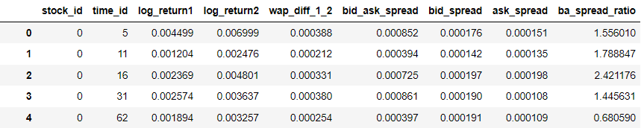
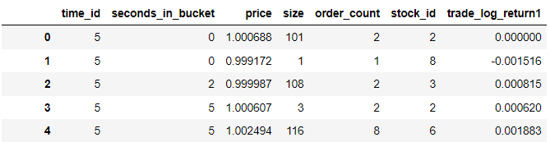
Data - Aggregation
Aggregated the book data at time_id level (from seconds)
Did the same thing for trade data

Slide 9
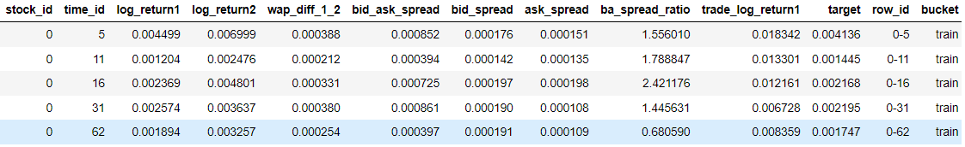
Data - Aggregation
Merged the Book Data, Trade Data, and Train.csv (has the target variable)
Divided the merged data into Training and Testing Data (70%:30%).
For each stock, 70% of the initial data (wrt. time) assigned as Training and the rest as Testing data.
feature_columns = stock_id, log_return1, log_return2, trade_log_return1, wap_diff_1_2, bid_ask_spread, bid_spread, ask_spread, ba_spread_ratio

Slide 10
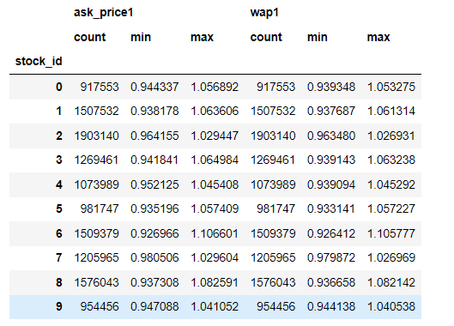
EDA
Count, min and max for different stocks

Slide 11
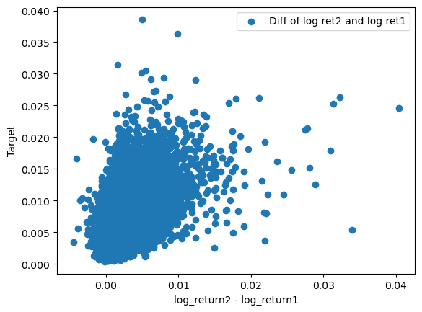
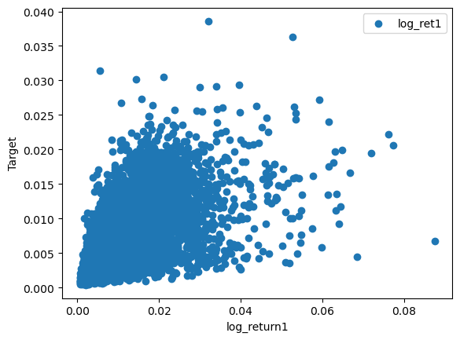
EDA
Plot for Target vs Log Return 1 and Target vs Difference of Log Return

Slide 12
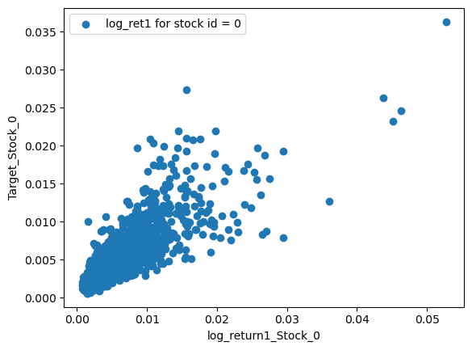
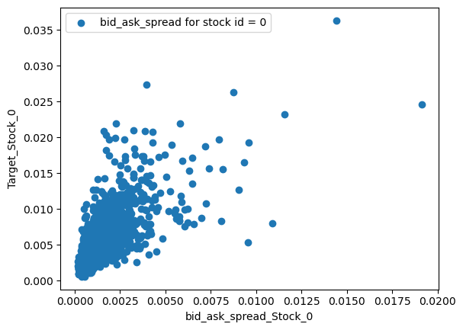
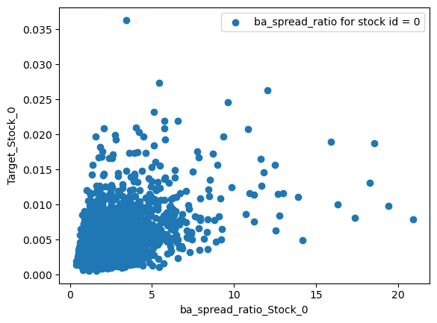
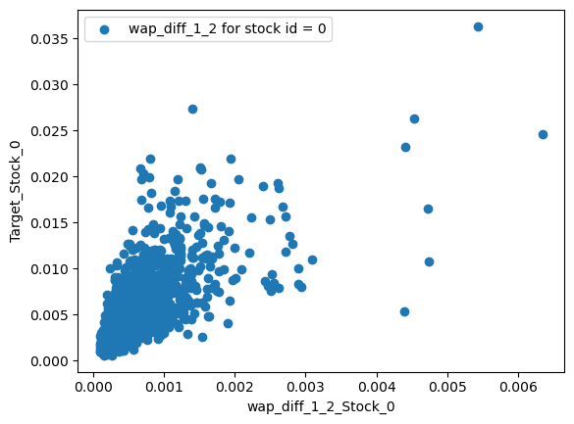
EDA
Plot for Target vs various measures for Stock ID = 0

Slide 13
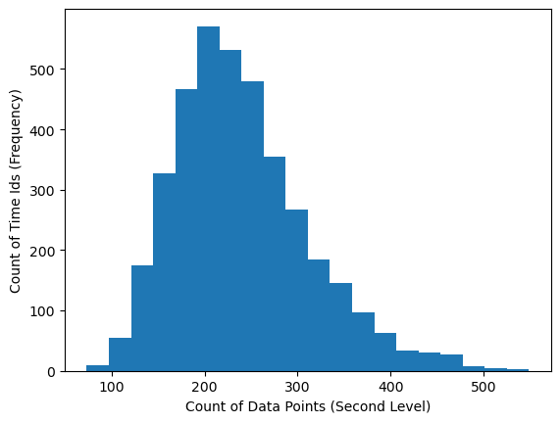
EDA
Histogram to check the distribution of Number of Data Points present for Time_ID.

Slide 14
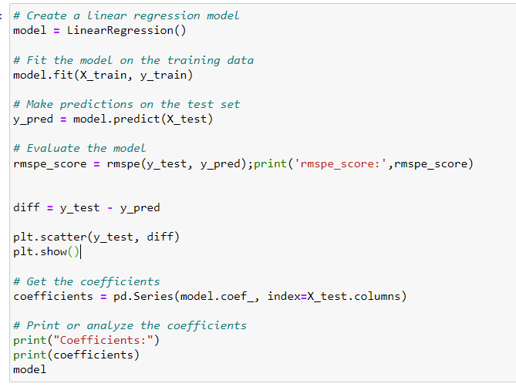
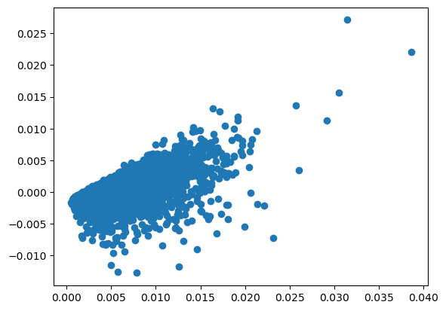
Model - Linear Regression
rmspe_score: 0.4531
Plot of errors (x) vs Target (y)

Slide 15
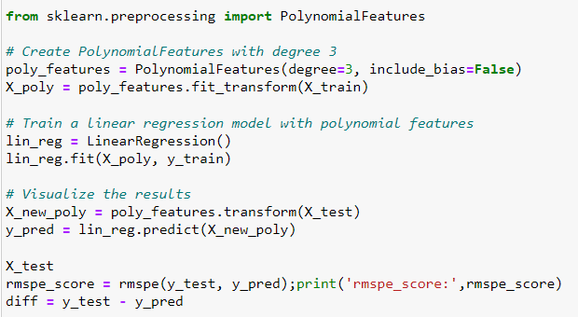
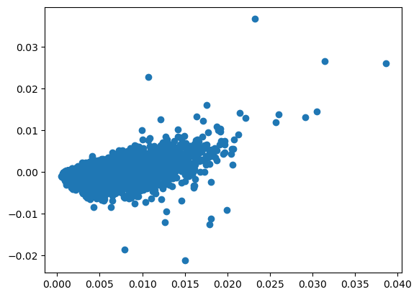
Model - Polynomial Regression
rmspe_score: 0.3473
Plot of errors (x) vs Target (y)

Slide 16
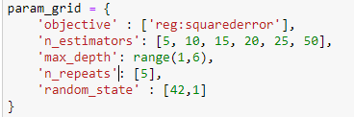
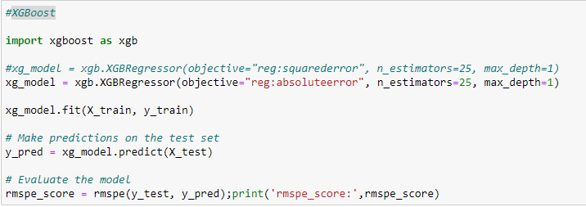
Model - XGBoost
rmspe_score: 0.4056
CV -> rmspe_score: 0.3537

Slide 17

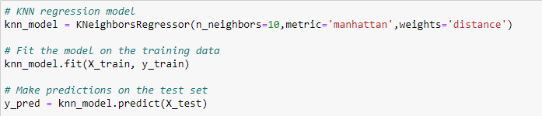
Model - KNN Regression
rmspe_score: 0.4361
CV -> rmspe_score: 0.4444

Slide 18
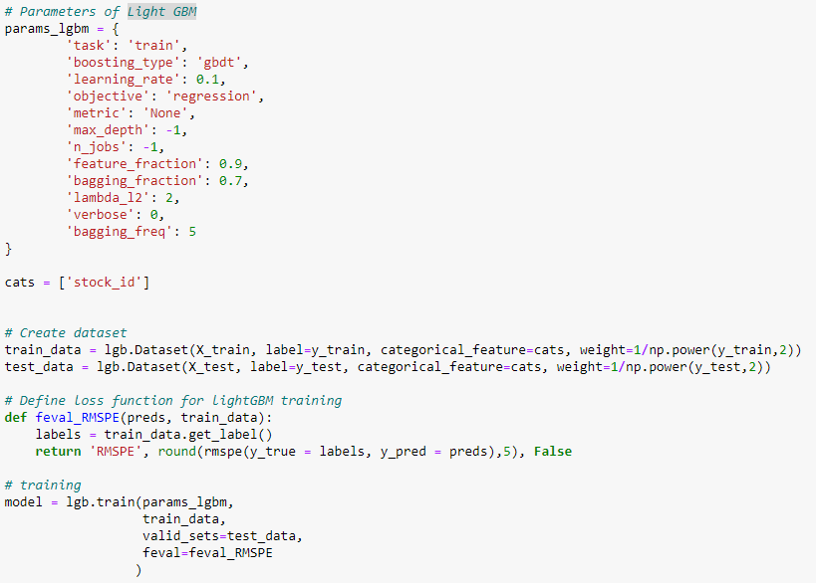
Model - Light gradient-boosting (Light GBM)
rmspe_score: 0.2634
CV -> rmspe_score: 0.2632
Performed 10 Fold CV (No changes in the params)

Slide 19
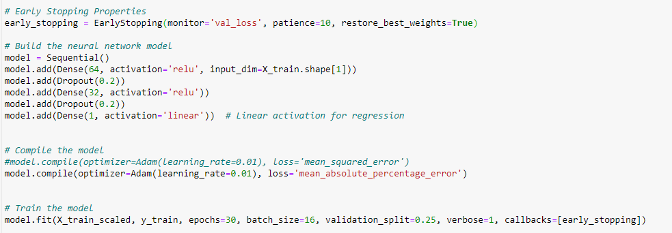
Model - Simple Regression Neural Net
rmspe_score: 0.4557
Problem - Widely varying rmspe scores when we change batch_size, learning_rate

Slide 20
Model - Future Work
Optimize Light GBM
Hyperparameter tuning
Understand Feature importance
Extend the solution to the Actual Market Data

Slide 21
Model Comparison
 | RMSPE
 | Normal | Grid Search and CV
Linear Regression Model | 0.4531
Polynomial Regression Model | 0.3473
KNN regression model | 0.4361 | 0.4444
XGBoost | 0.4056 | 0.3537
Light GBM | 0.2634 | 0.2632
SVR | 5.967 | 5.967
Neural Net - Simple Regression | 0.4557

Slide 22
Conclusion
Best Model - Light GBM with RMSPE score as 0.2632
This suggests that the volatility prediction should be done keeping error threshold of approx 26%.

